Slide 1

Hii,
Iam Siddhika
Welcome to Power BI Series
Part -83

Slide 2



Today Content
I’m very excited to dive into this with you all!
Are you ready to enhance your data visualization skills?
VISUALIZING DATA
PARAMETERS (CONTINUATION) 2.NUMERIC RANGE PARAMETER EXAMPLE:WHAT-IF ANALYSIS

Slide 3

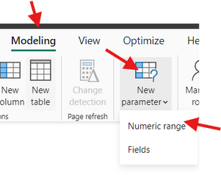

2.CREATING A NUMERIC RANGE PARAMETER FOR "WHAT-IF" ANALYSIS
check next slide..
Objective: Allow users to perform a "What-If" analysis by dynamically adjusting the discount percentage and observing its impact on Total Sales.
Open your Power BI report. Navigate to the Modeling tab in the top menu.
Step 1:
Click on New Parameter and select Numeric Range from the dropdown. This option allows you to create a parameter where users can adjust numeric values, perfect for "What-If" scenarios.

Slide 4

Step 2:Define the Numeric Parameter:
see next
Name: Enter a name for your parameter, such as "Discount Percentage."
Data Type: Set it to Decimal Number.
Minimum Value: Set the minimum discount, for example, 0 (representing 0%).
Maximum Value: Set the maximum discount, for example,
0.5 (representing 50%).
Increment: Set the increment value, such as 0.01 (representing 1%).
Default Value: You can set an initial default value, like 0.1 (10%).
Add Slicer to This Page: Make sure this option is checked so that a slicer is automatically added to your report page
slide ..

Slide 5
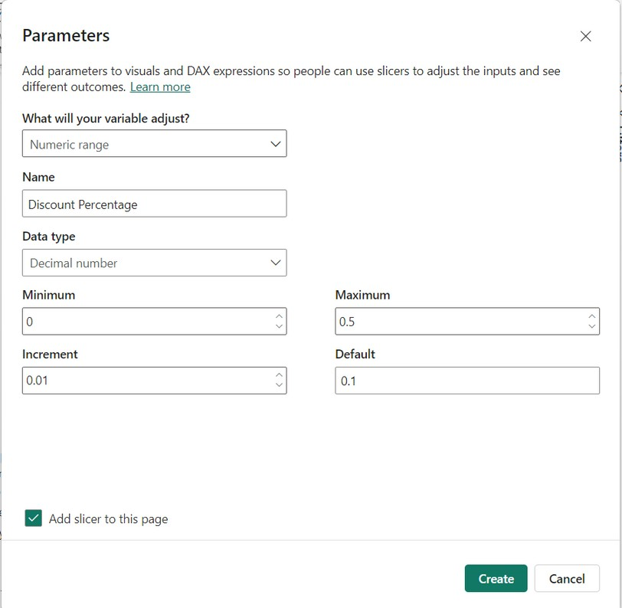
do along with
me

Slide 6
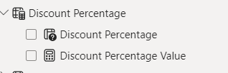
Step 3:Create the Parameter
After setting up the parameter, click Create. Power BI will generate two measures:
Parameter Definition Measure: Defines the range of the parameter.
Selected Value Measure: Captures the value selected by the user.
Easy..see
next

Slide 7
Step 4:Create a Calculated Measure:
create a new measure to apply the discount.
try it..
This measure calculates the total sales after applying the selected discount percentage.
Step 5:Add a Visual
Drag a visual, such as a Clustered Column Chart onto your report canvas.

Slide 8
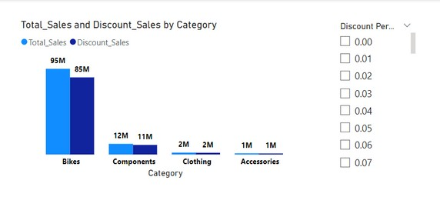
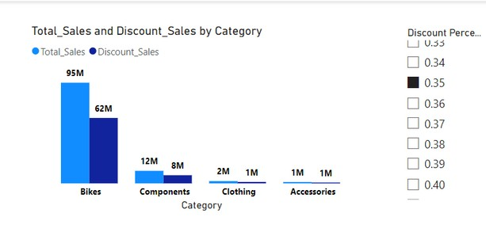

Step 6:Set Up the Visual
Y-Axis: Drag Total Sales and Discount_Sales measure to the Y-axis of your visual.
X-Axis: Drag Category field to the X-axis.
Step 7:Use the Discount Percentage Slicer:
Now, interact with the slicer added by the parameter. Adjust the discount percentage and observe how the Total Sales value changes dynamically in the visual.
Go and
try..

Slide 9


Thank you for joining me today to learn about Part -83 of Power BI!
Remember, Effective data visualization is crucial for turning data into meaningful insights and compelling narratives with Power BI.
Stay tuned for more insights and tips on Power BI in our next Series.
Follow

